Slide 1
GEM Year 2 – Ear week Cases of the week
Chris Summers
Lecturer in Clinical Anatomy
Honorary Educational Registrar in Otorhinolaryngology
Rhodri Costello
Consultant in Otorhinolaryngology
ENT teaching lead
Simon Browning
Consultant in Otorhinolaryngology
Honorary Associated Professor

Slide 2
Cases
10 cases spanning the breadth of the week
In this session
Interactive discussion around the cases
Greater focus on those found difficult by the group

Slide 3
Case 1 – Emergency ENT referral

Slide 5
Case 1 Questions
Q1 On arrival to hospital under your care, what is your first concern?
What process should you start?
Unwell septic child!
ABCDE ALS principles
Sepsis 6

Slide 6
Case 1 Questions
Q2 This letter follows an SBAR format. What is SBAR?

Slide 8
Case 1 Questions
Q3 . Setting aside the current episode, the child has a number of risk factors for deafness. What are these?
FHx (Family history)
Toxoplasmosis
Glue ear Aka otitis media with effusion
Premature

Slide 9
Case 1 Questions
Q4 . What is neonatal screening and how is it done?
Bedside hearing screening for newborns
Automated OtoAcoustic emissions (AOAE) used
Sound played into earpiece of both ears
The ear emits a sound that can be picked up by receiver
https://www.youtube.com/watch?v=85GBPNvABQ8

Slide 10
Case 1 Questions
Q5 . The child has a subperiosteal mastoid abscess according to the referrer. This is one complication of acute otitis media.
Name 5 others.

Slide 11
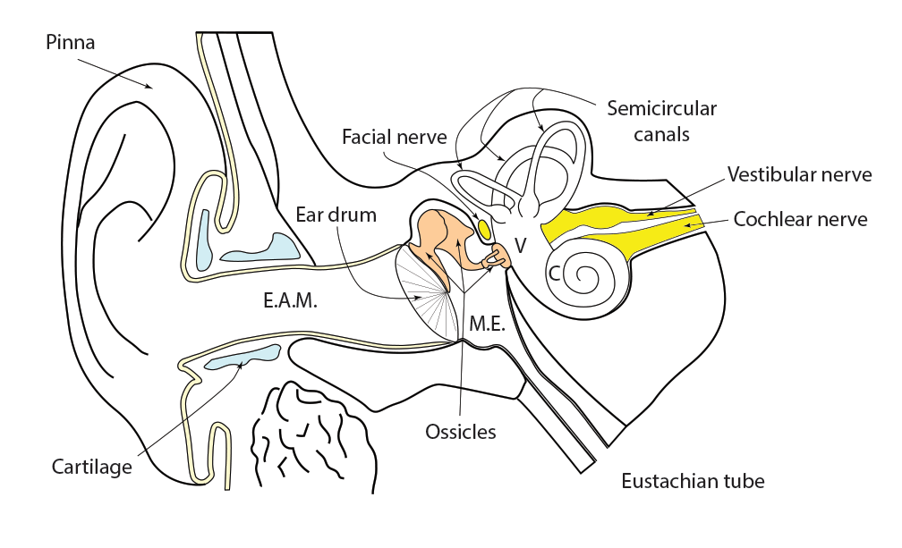
Complications of a middle ear infection

Slide 12
Case 1 Questions
Q5 . The child has a subperiosteal mastoid abscess according to the referrer. This is one complication of acute otitis media.
Name 5 others.
Labyrinthitis,
CNVII palsy
Meningitis
Brain abscess
Neck abscess

Slide 13
Case 1 Questions
Q6. What other general concern do you have about the child and how would you address it?
Neglect
Consider safeguarding referral

Slide 14
Case 2 – Emergency phone referral
Transcript Emergency phone call from GP at bedside of patient with acute, severe, vertigo. 2am.
“Good Morning, Mr. Johannes its Dr. Muller here, the duty on-call for the local GP practice.
I’m with a 24-year-old man who is extremely vertiginous and has nausea and vomiting. His vertigo is worse whenever he moves, and he is more or less immobile in bed.
Just to give you some background, this is the first time that he has had vertigo and he is usually pretty fit and well apart from some grumbling problems with recurring ear infections. His GP has been giving him ear drops for recurring left otitis externa for a few years now. His ear is usually very bad smelling during an attack, but he doesn’t get much in the way of ear pain with it. The drops clear up the smell nicely. He always has some deafness on the left though.
PMH. Nil in the past and no obvious family history of vertigo.
Examining him he looks pale and sweaty, and he is very reluctant to move. He has nystagmus but it is difficult to tell which way its going. I haven’t got any tuning forks with me, I’m afraid. I had a look in his ears but couldn’t see very much because he wouldn’t move to allow examination. His pulse is around 110 but there is no fever and BP is normal.
In summary, I think that he has a diagnosis of vertigo. Can you admit him for hydration please? He looks quite dry. “
Many thanks,
Dr. Muller, Out of Hours GP.

Slide 15
Case 2 Questions
Q1 . The patient appears to be suffering with recurring ear infections. What is the differential diagnosis for this? Give 3 suggestions.
Otitis externa
Perforation
Cholesteatoma
Others could include
Eczema
Fungal infection
Foreign body

Slide 16
Case 2 Questions
Q2 . The patient also has left-sided hearing loss that appears to persist despite treatment. The doctor didn’t have tuning forks with him. What would tuning forks show if,
this was a sensory deafness,
Weber’s lateralises to the right
Rinne’s air louder than bone in both (AKA +ve B/L)
this was a conductive deafness
Weber’s lateralises to the left (finger in ear)
Rinne’s
Right - air louder in bone (+ve)
Left – Bone louder than air (-ve)

Slide 17
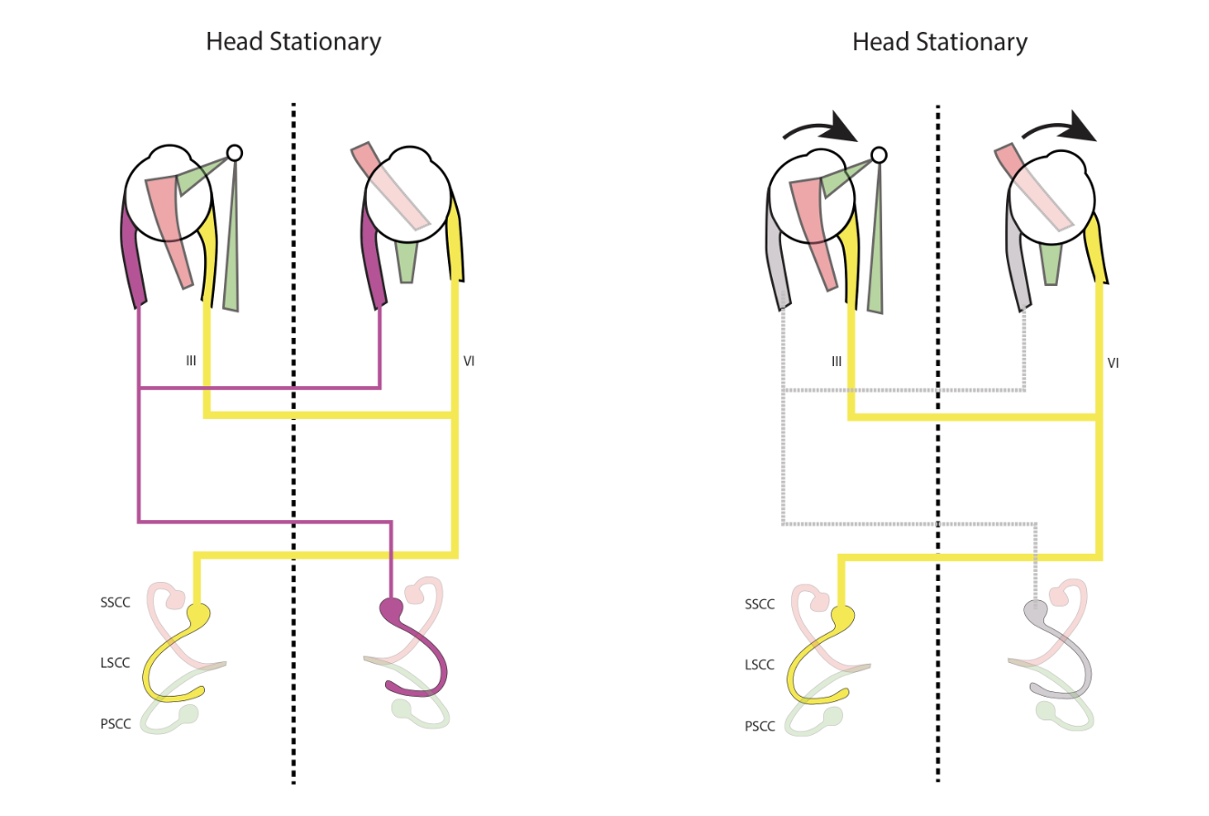
Case 2 Questions
Q3. Assuming that his vertigo is caused by left-sided ear disease, which way will the nystagmus beat?
Fast phase to the right
VI
VI

Slide 18
VI
VI
Left sided ear disease
Normal ear

Slide 19
Why does he have a right beating nystagmus?

Slide 20
Why does he have a right beating nystagmus?

Slide 21
Why does he have a right beating nystagmus?

Slide 22
Why does he have a right beating nystagmus?

Slide 23
Why does he have a right beating nystagmus?

Slide 24
Why does he have a right beating nystagmus?

Slide 25
Why does he have a right beating nystagmus?

Slide 26
Speed that up to real time…

Slide 48
Case 2 Questions
Q4. When treating Otitis Externa (OE), what options work best when the ear drum is visible?
Topical Antibiotics , topical acetic acid (NICE), cleaning may be necessary

Slide 49
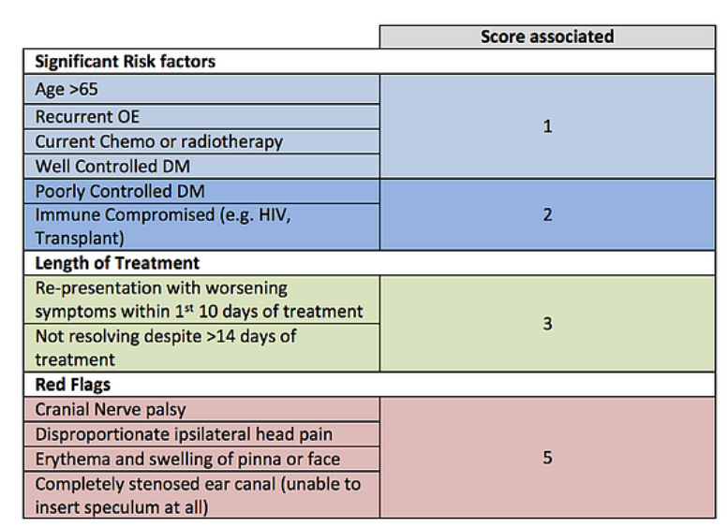
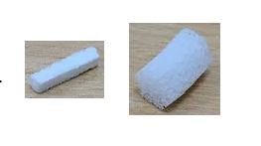
Case 2 Questions
Q5. What if the eardrum is not visible and the ear canal is completely closed by oedema?
Insertion of a pope wick

Slide 50
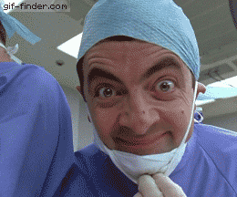
Case 2 Questions
Q6. Is the doctor correct with his diagnosis?
No Vertigo is a symptom NOT a disease!

Slide 51
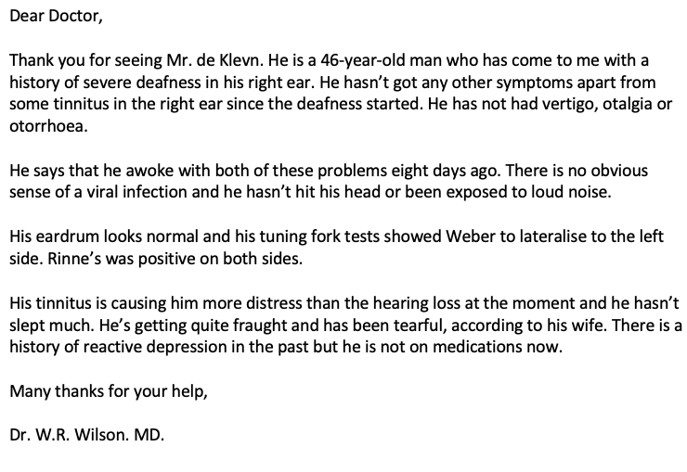
Case 3 Sudden SNHL

Slide 52
Case 3 Questions
Q1. The tuning fork tests reveal which type of hearing loss, conductive or sensorineural?
Sensorineural hearing loss
Weber’s lateralises away from side
Rinne’s Air > bone (+ve)

Slide 53
Case 3 Questions
Q2. The GP has referred this as a routine case. Is this reasonable? Justify your answer.
No, it is an emergency ! Time is neural tissue

Slide 54
Case 3 Questions
Q3. Define tinnitus. How common is it in a general population?
1:10 persistent
40% intermittent
increasingly common with age

Slide 55
Case 3 Questions
Q4. Give a differential diagnosis for sudden sensory deafness. 4 causes will be sufficient.
idiopathic/viral
trauma
vascular
Bacteria
Q5. Are there any treatments for sudden sensory hearing loss?
Steroids (Oral or Intratympanic)

Slide 56
Case 3 Questions
Q6. Once you have seen the patient and confirmed a sensory deafness, which test should you order?
MRI IAM or CP angle rule of Vestibular Schwannoma
Q7. How is tinnitus managed?
Explanation and reassurance
Environmental masking
Attention switching
Hearing aids if deaf
Psychological approaches (CBT Cognitive Behavioural Therapy)

Slide 57
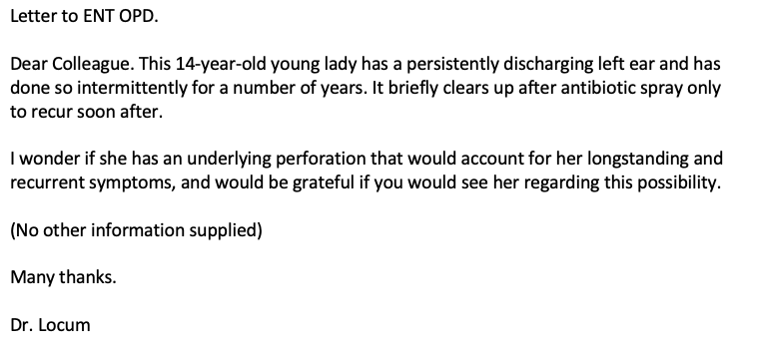
Case 4 Otorrhoea Poor referral

Slide 58
Case 4 Questions
Q1. What other information could have been supplied by the doctor to help you triage the referral as routine, urgent or urgent suspected cancer?
Otoscopic findings, hearing status and tuning forks, impact of problems, comorbidities, impact of swimming/water, drugs etc
Q2. If this recurring infection is caused by a perforation, what would the tuning forks show?
Weber’s lateralising to the left
Renne’s left ear bone louder than air (-ve)

Slide 59
Case 4 Questions
Q5. Typically, what is the discharge caused by an infection like?
higher volume, mucoid/pus, bubbles, inoffensive
Q6. How might the history be different if the cause of her problems were a cholesteatoma?
Foul smelling, scanty discharge

Slide 60
Case 5 Vertigo

Slide 61
Case 5 Questions
Q1. Mrs. Foster has symptoms that are classic for which vestibular disease?
BPPV Benign paroxysmal positional vertigo
Q2. What is the most likely cause for her hearing loss?
Presbyacusis - aging related hearing loss
NOT associated with vertigo
Q3. Why is this history not typical of Ménière’s Disease?
Duration, absence of Hearing loss & Tinnitus

Slide 62
Case 5 Questions
Q4 What is the significance of the findings during a Dix-Hallpike test?
Supports a diagnosis of BPPV
Q5 Why should this lady be prioritised as urgent?
Osteoporosis and risk of fracture, tendency to fall
Q6. What treatments might be offered when she gets to see the ENT Department?
Epley manoeuvre

Slide 63
Case 6 ? Ménière’s disease

Slide 65
Case 6 Questions
Q1 In what ways are Ménière’s and Migraine similar?
Duration of attack Hours – Day (classically)
Prodrome aura (migraine) aural pressure (Ménière’s)
?related to diet
both associated with vertigo
both associated with BPPV
both potentially very disruptive to life
Q2 What medication and lifestyle advice could the GP give to the patient to help with his problem?
Reduce salt in the diet and stress
Serc TDS (Betahistine)
Stemetil prn

Slide 66
Case 6 Questions
Q3 What non-ear diseases may cause recurring bouts of dizziness?
Dysrhythmia
Anxiety/panic attacks
Migraine
Diet
Epilepsy
Neck disease….
Q4 If simple measures fail to assist, what surgical options are there for helping the patient?
Grommet, Intratympanic therapy, labyrinthectomy/Vestibular nerve section

Slide 67
Case 6 Questions
Q5 What advice should the GP give to the patient about his driving?
Should not drive with vertigo or after warning symptoms
Should contact the DVLA for review of licence

Slide 68
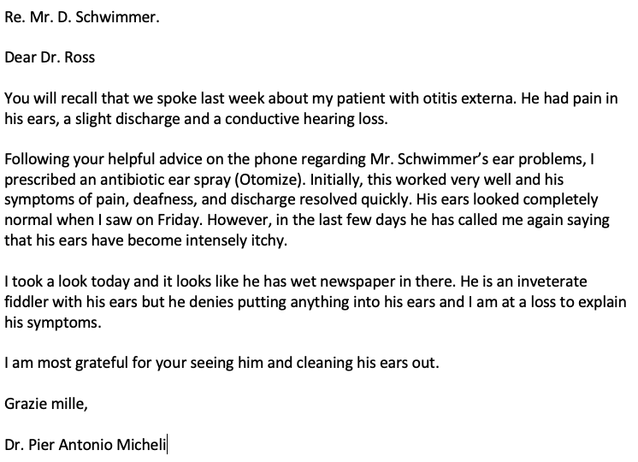
Case 7 Recurrent otitis
Dr. Mitcheli
Ffwng surgery
Swansea

Slide 70
Case 7 Questions
Q1 Recurring otitis externa is sometimes called swimmer’s ear because it is common in water sports enthusiasts. What simple advice can you give to a patient with recurring problems regardless of the cause?
Keep ears dry
Don’t instrument them
Don’t rub them when they itch
Use ear plugs
Q2 Topical antibiotics are commonly prescribed without bacterial swabs being taken. Why is this justifiable?
Common pathogens
Wide antimicrobial activity
Waste of time/ logistic issues

Slide 71
Case 7 Questions
Q3 Which commonly used topical antibiotic often causes a type 4 hypersensitivity problem?
Neomycin
Q4 In addition to topical hypersensitivity, antibiotic usage can encourage fungal otitis externa (otomycosis). What are the common infecting fungi?
Candida albicans
Aspergillus niger
Aspergillus flavus
Q5 How is otomycosis treated?
Topical antifungals – 4 weeks & Aural toilet

Slide 72
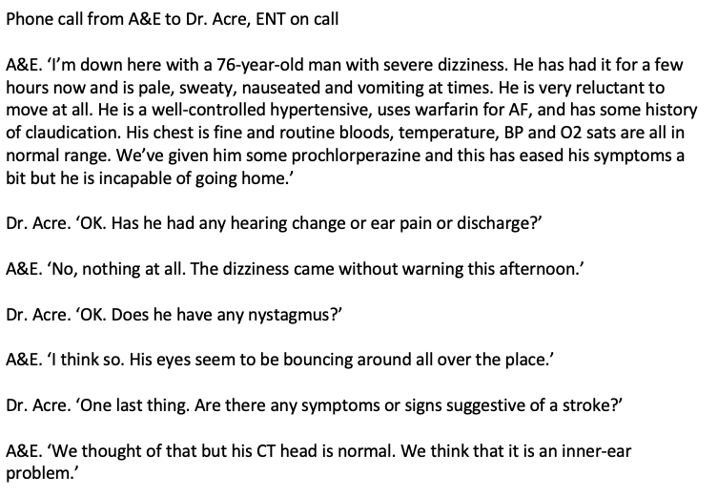
Case 8 Telephone advice

Slide 73
Case 8 Questions
Q1 The patient has sudden onset, severe vertigo without hearing changes. When examined, his eardrums were normal and his nystagmus was left-beating. Which is more likely a stroke or acute inner ear disease such as vestibular neuritis?
Vestibular neuritis
Q2 What do the terms; timings, triggers and associations mean in relation to vestibular history taking?
Q3 What is the ‘timing’ in this case? What about a trigger?
Hours, No trigger

Slide 74
Case 8 Questions
Q4 What will the nystagmus show if this is a left-sided inner ear condition?
Right beating nystagmus in all directions of gaze
Q5 What is the vestibulo-ocular reflex and how is it tested?
The head impulse test (more on this in year 3)
Q6 Further question: what is the likelihood of a CT showing a CVA within the first few hours of onset of symptoms?
Low

Slide 75
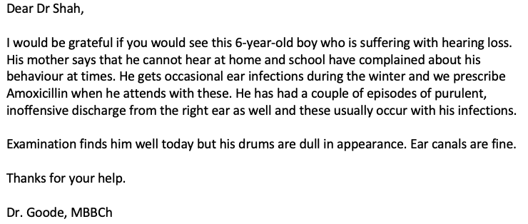
Case 9 Child with hearing loss

Slide 76
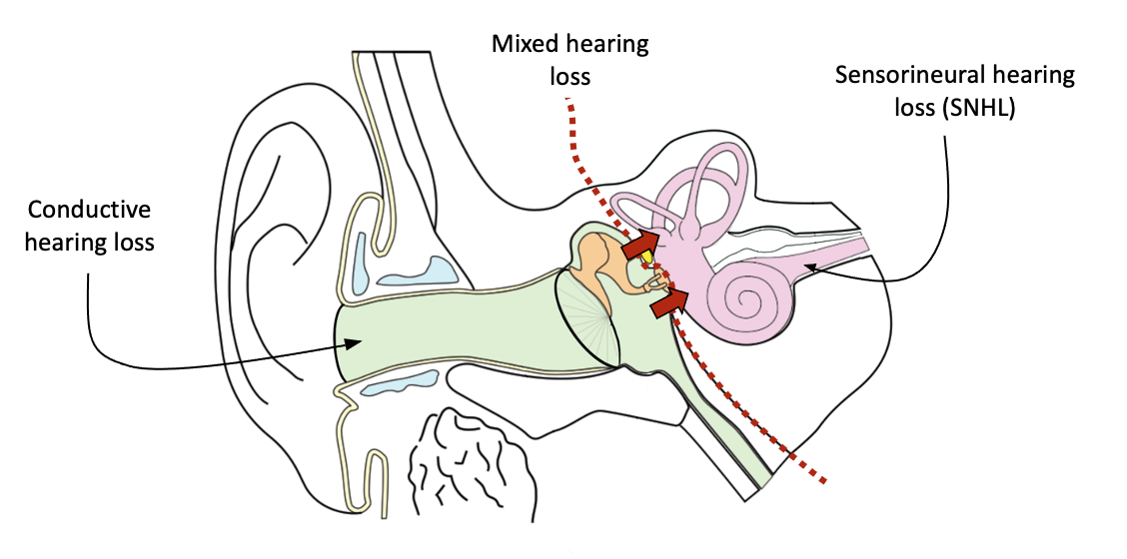
Case 9 Questions
Q1 What is the most common cause of acquired deafness at age of 6?
Glue ear (Otitis media with effusion)
Q2 Is this a conductive or sensory deafness?
Conductive hearing loss

Slide 77
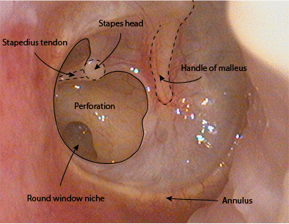
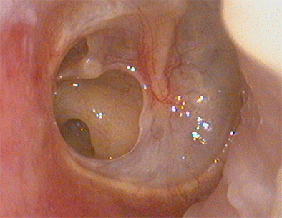
Case 9 Questions
Q3 Should the GP always treat these infections?
No most likely viral watch & wait is appropriate.
Q4 He gets episodes of ear infection during the winter and these are associated with aural discharge that is plentiful and yellow but is not offensive in smell. What is the likely cause of these infections?
Acute otitis media (AOME) with a perforation

Slide 78
Case 9 Questions
Q5 What is the impact on a child of having hearing loss?
Emotional
Educational
Speech
Social delay
Q6 What treatments exist for deafness in children?
Watch and wait, hearing aids, grommets

Slide 79
Case 10 Elderly patient with hearing loss

Slide 80
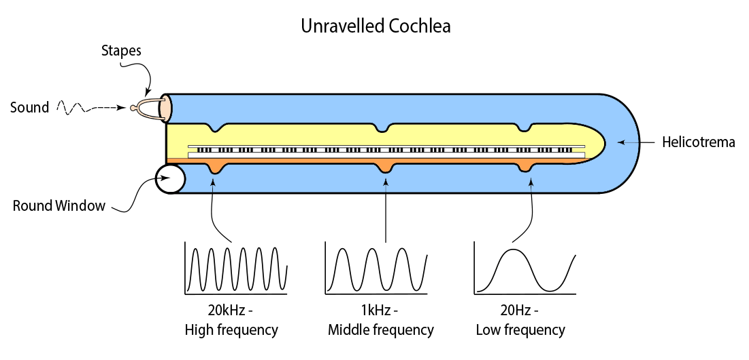
Case 10 Questions
Q1 . What is the hearing loss associated with age known as?
Presbyacusis (aging related hearing loss)
Q2 . What other causes for hearing loss may she have based upon her history?
Noise induced hearing loss (NIHL)
Q2 . What would the audiograms look like in these cases?

Slide 81
Case 10 Questions
Q4 . Why does the hearing loss of age cause difficulty hearing speech?
Loss of high frequency consonant sounds
'e ui o o u oe e a o’
'Th qck brwn fx jmps vr th lzy dg’
Q5 . What rehabilitation will she be offered?
Hearing aids, listening skills
Q6 . What are socioacusis and nosocusis?

