Slide 1
Vestibular Neuritis (not neuronitis)
Simon Browning

Slide 2
Objectives
Know the vascular and neural anatomy of the membranous labyrinth
Know the symptoms and signs of Vestibular Neuritis (VN) and how it differs from Labyrinthitis
To be able to differentiate benign VN from serious cerebrovascular disease at the bedside (objective completed in year 3)
Know to manage thrombotic risk in patients with symptoms of vestibular failure

Slide 3
Definition of Vestibular Neuritis
A benign, self-limiting condition lasting days or weeks
A clinical diagnosis
Your task, when presented with it, is to differentiate it from central cerebrovascular disease that shares similar history and clinical findings – so its an important one.

Slide 4
To whom does it present?
GP
A&E
General Medical take
Neurology
Old Age Medicine
ENT – rarely
So, there is a very good chance that you are going to come across it and you will need to be sure that the patient hasn’t had a stroke

Slide 5
Common Otologic Causes of Vertigo
Third Most Common Vestibular Disease

Slide 6
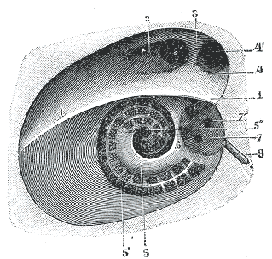
Neural Anatomy – Vestibular Nerves
The Right Internal Acoustic Meatus viewed from the brainstem
The Right Labyrinth viewed from the brainstem

Slide 7
Neural Anatomy of Labyrinth
If one or both nerves are damaged
then vestibular symptoms arise

Slide 8
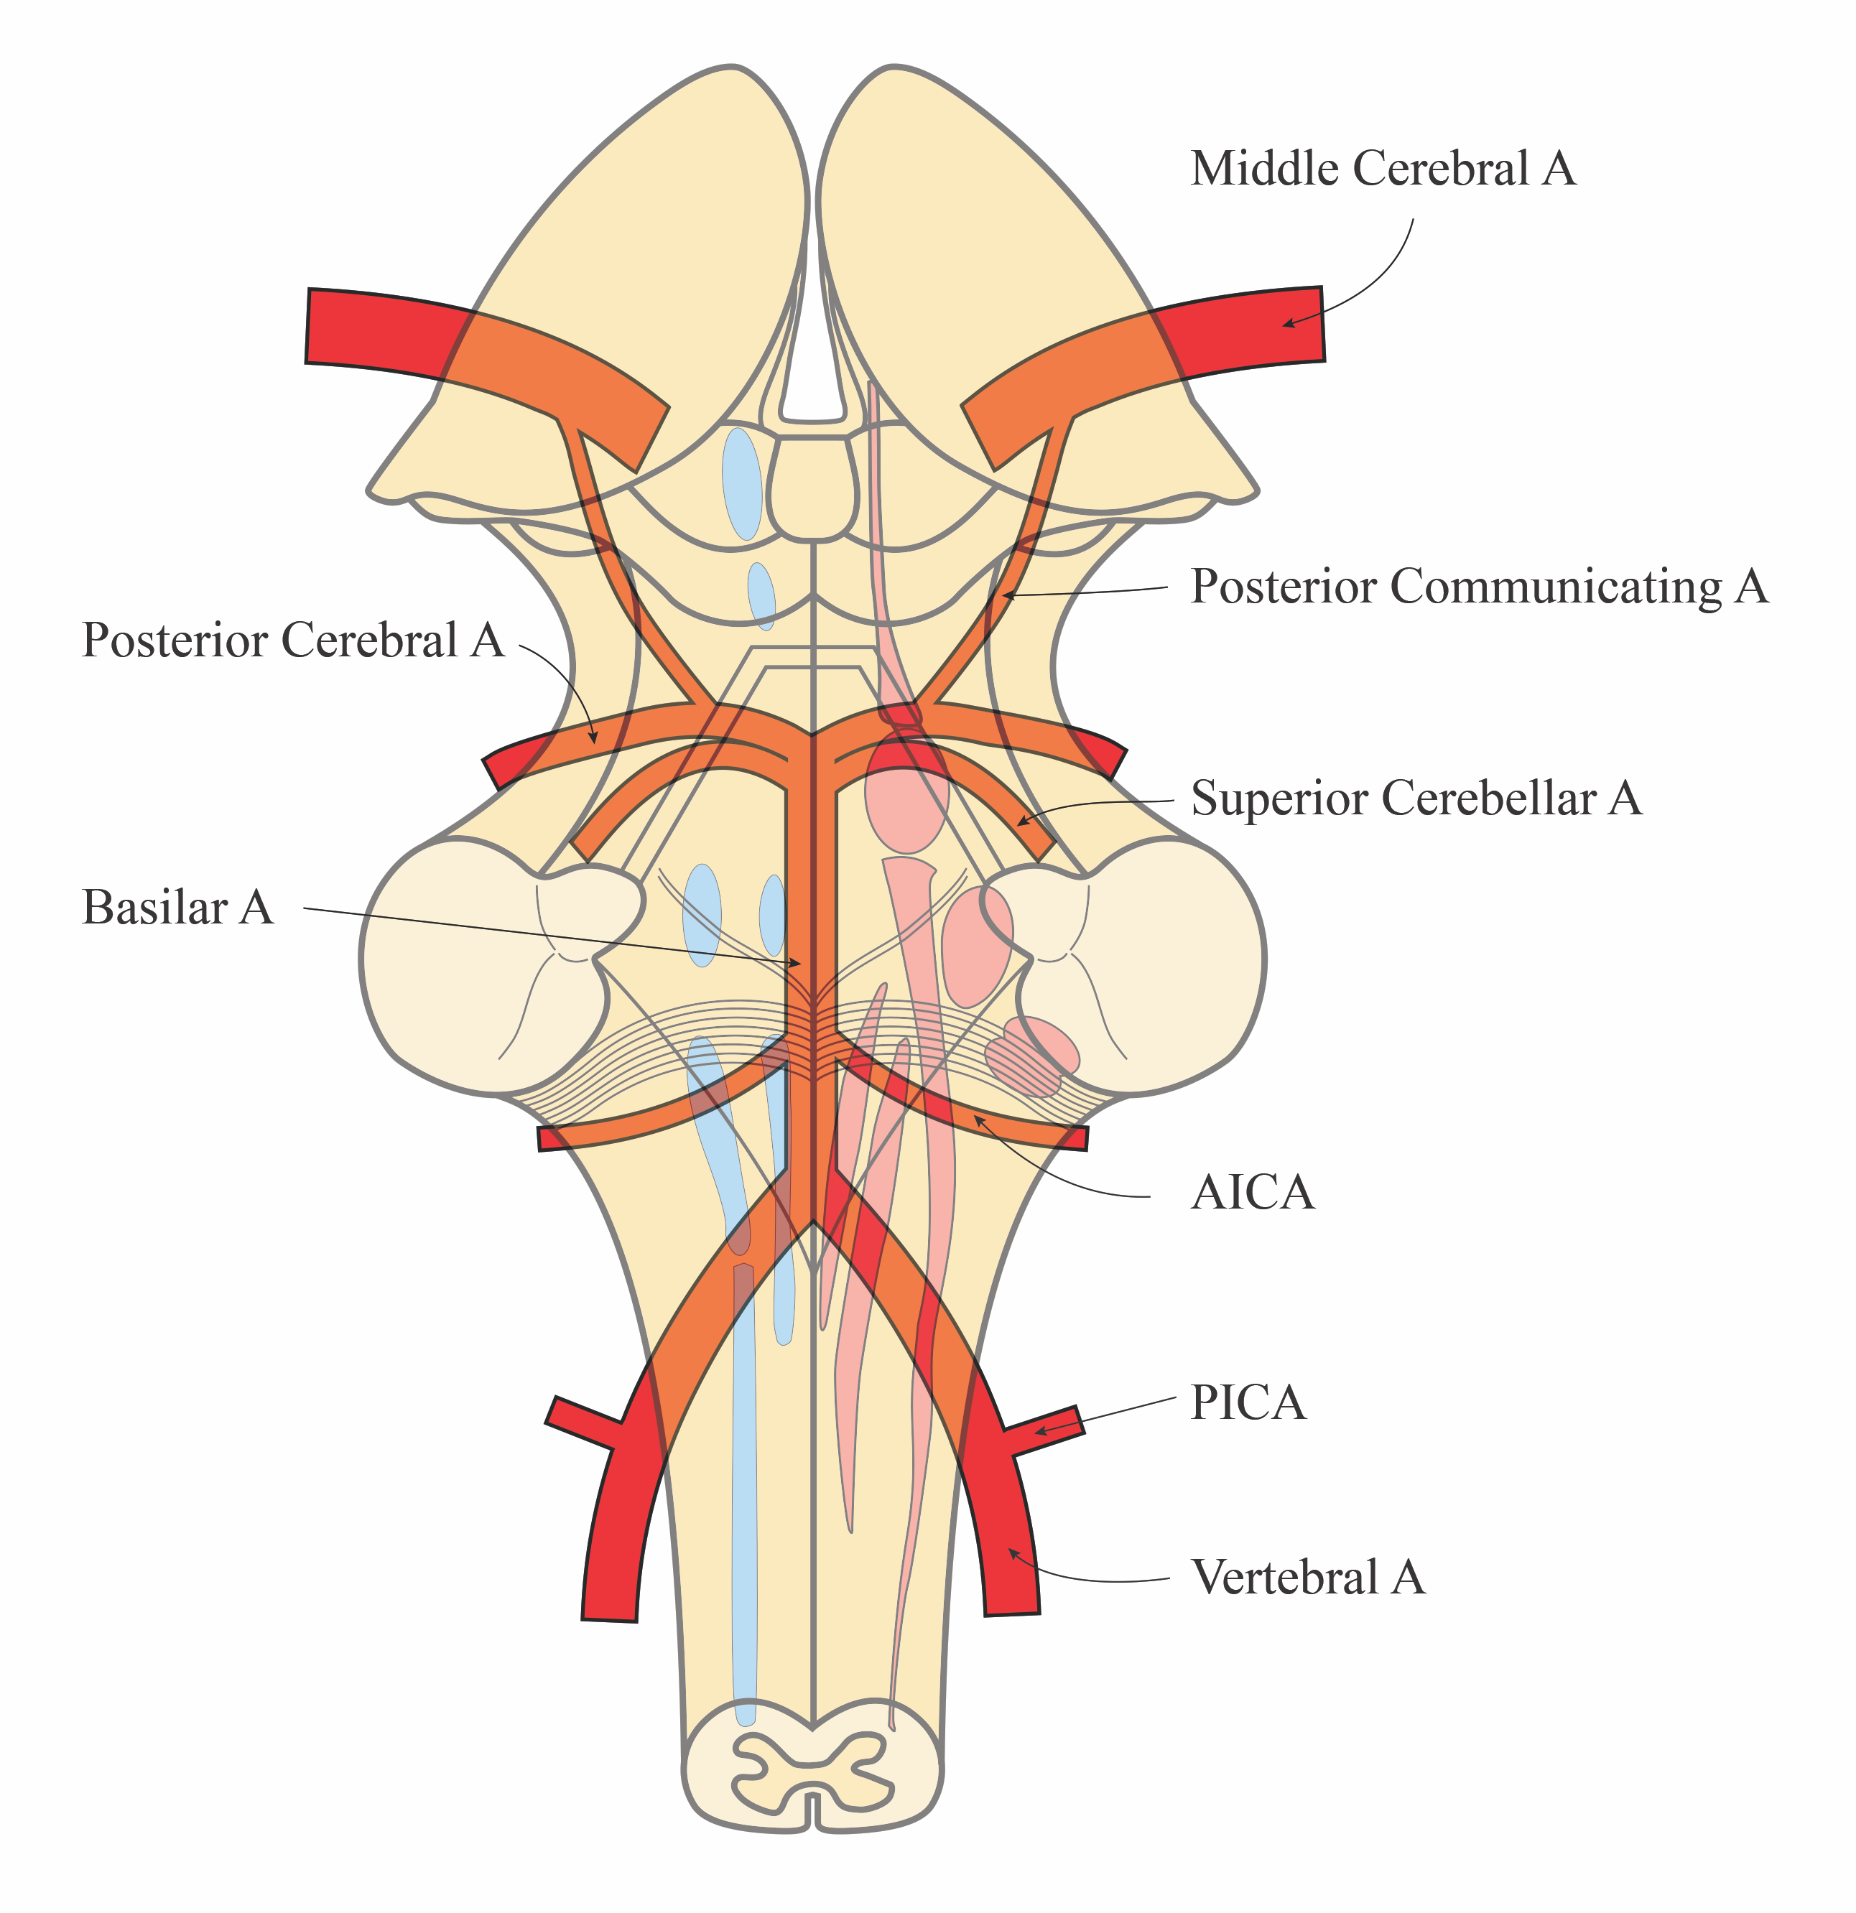
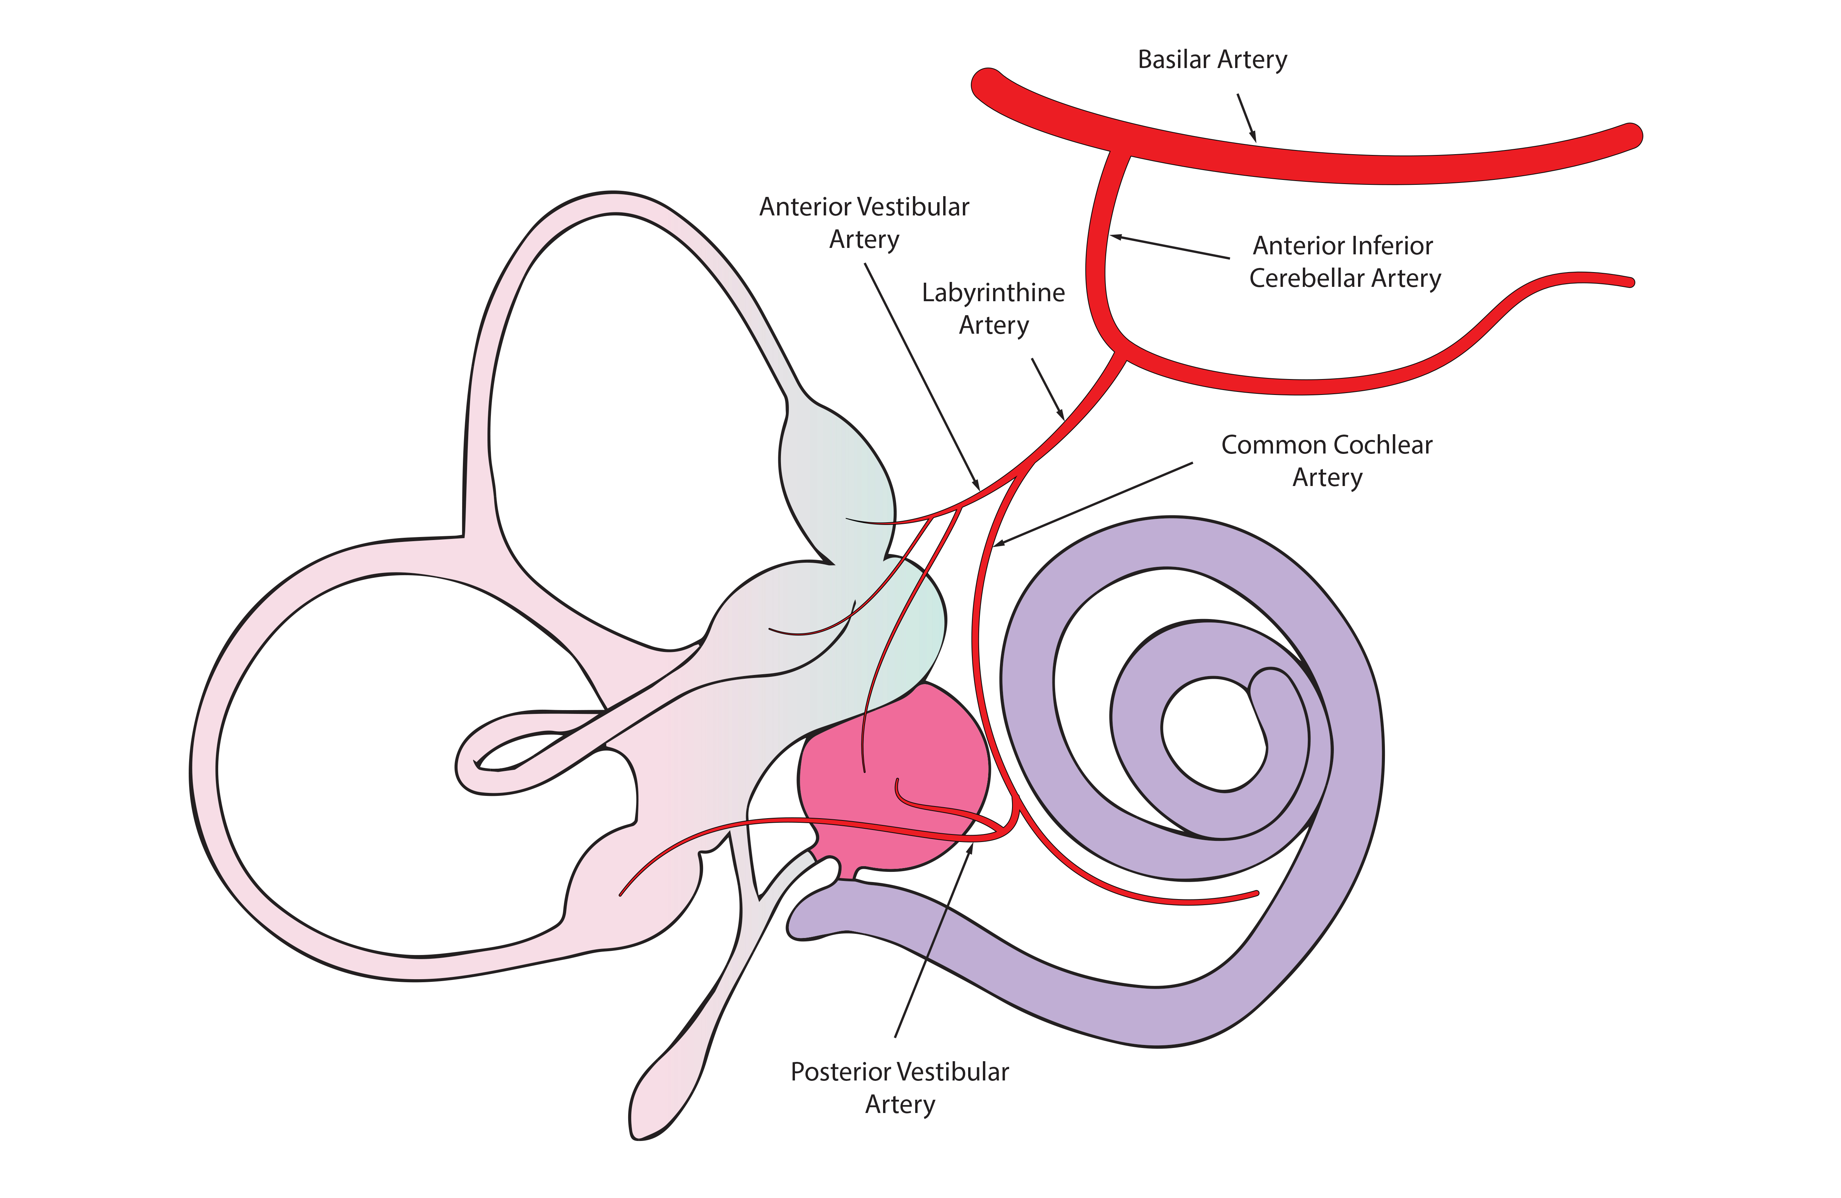
Vascular Supply of the Labyrinth
Notes:
The basic facts:
1. The posterior fossa of the cranial cavity contains very complex neuroanatomy.
2. Tracts and nuclei are packed close together and share a common blood supply
3. The likelihood of vertigo happening in isolation from any other symptom when there is vascular occlusion or haemorrhagic stroke is very very small because of thios anatomy
4. Therefore, vertigo in isolation is most likely to be inner ear disease and not a brain disease
5. Vertigo with: facial weakness or slurring of speech or weakness in a limb or cerebellar signs other than nystagmus etc are not caused by ear disease.

Slide 9
Vascular Anatomy – an End Artery System
Obstruction of the anterior vestibular artery
causes vertigo only
Obstruction of the labyrinthine artery
causes vertigo AND sensory deafness

Slide 10
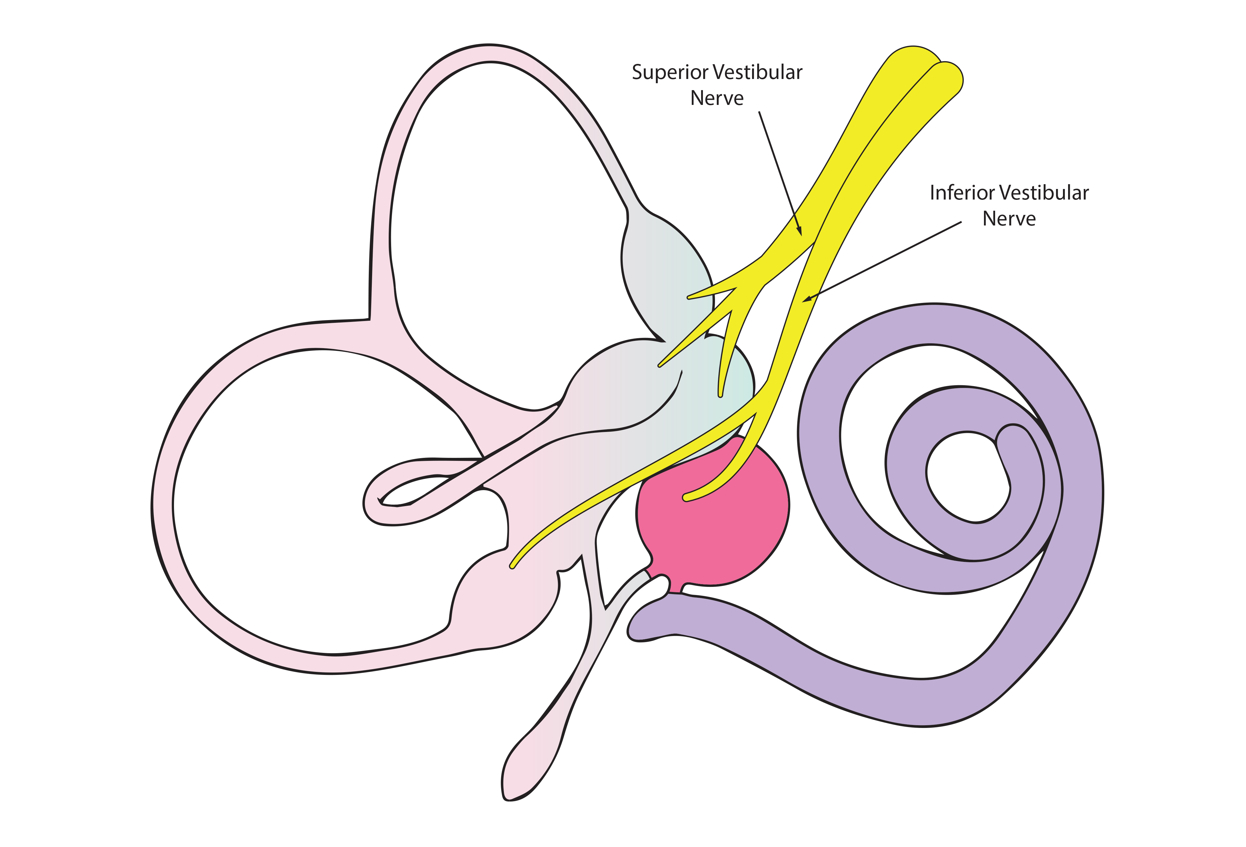
What is the difference between Vestibular Neuritis and Labyrinthitis? The difference is in the name…
Vestibular Neuritis (vertigo only)
Labyrinthitis (vertigo and sensory deafness)
VN – vestibular symptoms only
Labyrinthitis – vestibular and cochlear symptoms

Slide 11
What is the Difference Clinically?
Vestibular Neuritis
Labyrinthitis
Vertigo
Nausea and vomiting
Pallor, sweating, diarrhoea
Motion intolerance
Vertigo
Nausea and vomiting
Pallor, sweating, diarrhoea
Motion intolerance
Sensory deafness
+/- Tinnitus

Slide 12
Causes
Vestibular neuritis
Labyrinthitis
Viral infection / reactivation in superior, inferior or both vestibular nerves, or in the vestibular ganglion
Herpes group viruses possibly
Vascular
Viral or bacterial infection within the inner ear compartment
Viral infections much the commoner of the two
Bacterial infections spread in from the middle ear or from meningitis – emergency care needed
Vascular

Slide 13
Vestibular Neuritis is a Clinical Diagnosis
Vertigo, dizziness, imbalance
Moderate to severe
Hours to days
Motion intolerance
Nausea +/- Vomiting
Neurological symptoms
New deafness

Slide 14
On Examination
Horizontal/torsional Nystagmus
Unidirectional Nystagmus
Obeys Alexander’s Law (Yr 3)
Loss of vestibulo-ocular reflex
Vertical nystagmus
Gaze evoked nystagmus
Doesn’t obey Alexander’s Law
Vestibulo-ocular reflex intact
Skew deviation of pupils
Other neurological signs

Slide 15
Nystagmus – Left Beating, Horizontal/Torsional
Right Sided Vestibular Disease

Slide 16
Head Impulse Test – Loss of VOR to Right
Right Sided Vestibular Disease

Slide 17
Natural Course of Vestibular Neuritis
Initially – continuous vertigo of varying intensity, nausea, vomiting (and deafness and tinnitus in the case of labyrinthitis)
All movements are distressing
Reduced severity after a few days but movement may still provoke dizziness
Gradual return of functional balance through a process called ‘vestibular compensation’
In Labyrinthitis, hearing may return with viral infections but rarely does with bacterial infections

Slide 18
Treating Vestibular Neuritis
Symptomatic treatment in the acute phase
Antiemetics / sedatives
Antibiotics are not needed
Fluid support in hospital sometimes
Early mobilization, push the patient to move and be active again
Most patients will regain balance function without help, but some need vestibular training
Recovery is linked to age, general condition, other morbidities, drug usage, and degree of vestibular loss
Remember that the cause could be thrombotic so manage thrombotic risk
Smoking, obesity, cholesterol, blood pressure

Slide 19
Summary
Vascular and neural anatomy show us that there are a few causes for the clinical symptoms and signs
Symptoms and signs follow the pattern of pathology
Only vestibular symptoms for VN
Vestibular and cochlear symptoms for labyrinthitis
Nystagmus is a cardinal sign and is towards the opposite ear
The vestibulo-ocular reflex is affected towards the affected ear
Diagnosis is clinical – beware of Neurological disease mimicking VN
Management is simple,
Vestibular sedatives for a day or two
Early mobilization
Vestibular symptoms generally settle but rehabilitation may be needed

